Slide 1

Demystifying Azure Security for Developers
Kevin Dockx
Architect
@KevinDockx | www.kevindockx.com

Slide 2
Overview of Azure Security
System-based access: service principals, application objects & managed identities
User-based access: making Entra ID behave according to the current best practices
Access Control
Coming Up

Slide 3

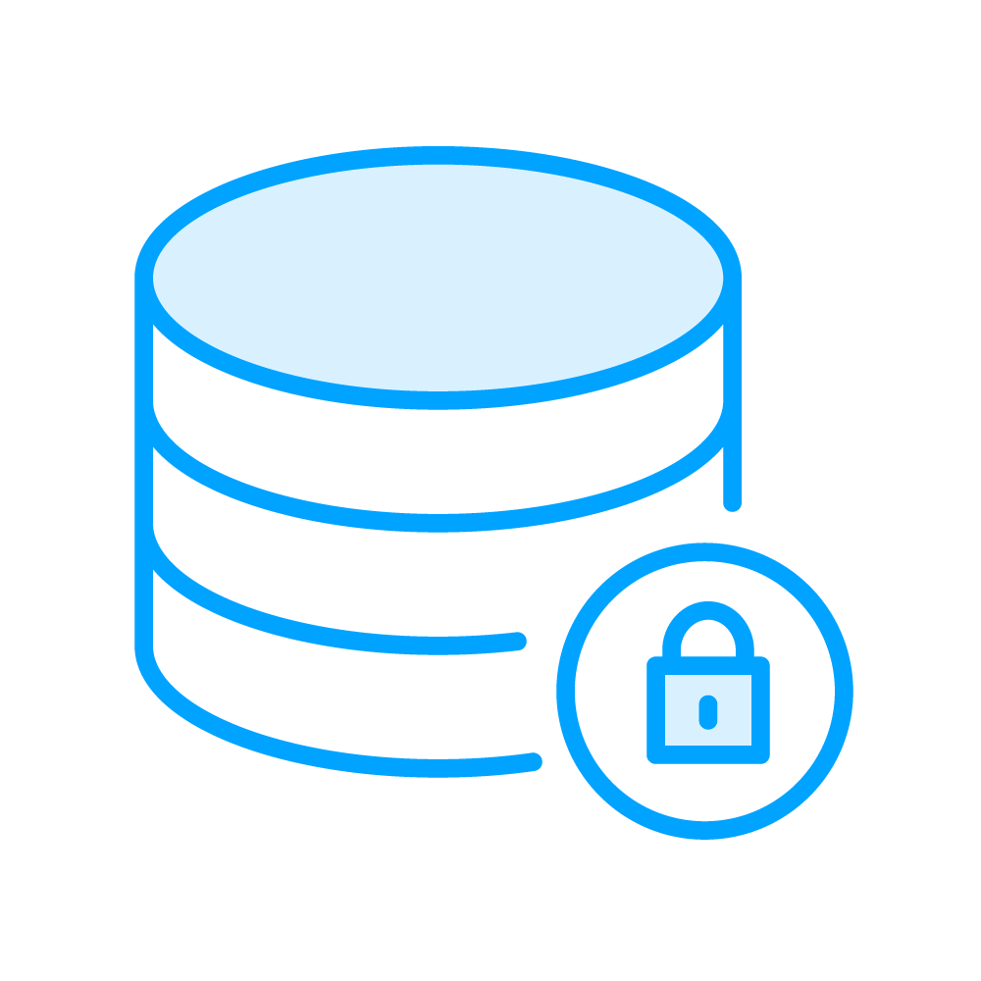

On Azure Security
General Azure security
Database security
Storage security
Notes:
Reference: https://learn.microsoft.com/en-us/azure/security/fundamentals/services-technologies
https://learn.microsoft.com/en-us/azure/security/fundamentals/best-practices-and-patterns

Slide 4



On Azure Security
IAM
Backup and disaster recovery
Networking
Notes:
https://learn.microsoft.com/en-us/azure/security/fundamentals/services-technologies
https://learn.microsoft.com/en-us/azure/security/fundamentals/best-practices-and-patterns

Slide 5
I’ll focus on what we typically encounter as a developer

Slide 6
Delegating IAM

Slide 7
Microsoft Entra ID
Microsoft Entra ID is a cloud-based identity and access management service that enables your employees to access internal (your own software) and external resources (M365, the Azure Portal, …)
(used to be called Azure AD)

Slide 8
Delegating IAM to Entra ID
To delegate identity and access management functions to Microsoft Entra ID, your applications need to be represented by something: you want to register an app

Slide 9
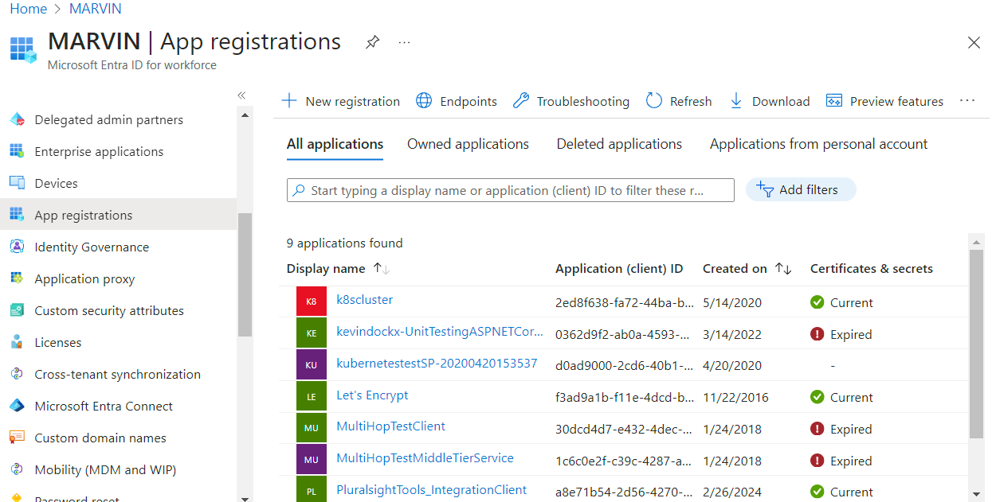
Entra App Registrations

Slide 10
Application Object
A globally unique instance of the app that lives within your home tenant or directory

Slide 11

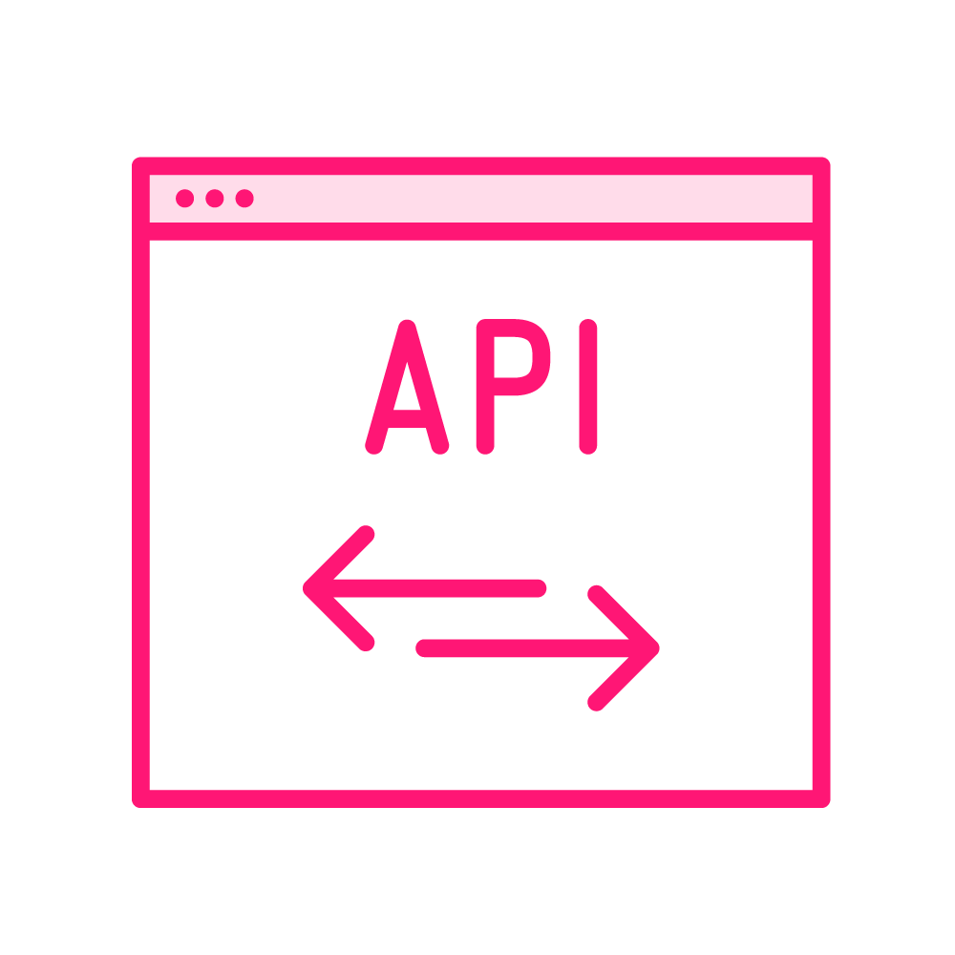

The Application Object Describes…
How tokens can be issued in order to access the application
The resources that the application might need to access
The actions that the application can take

Slide 12
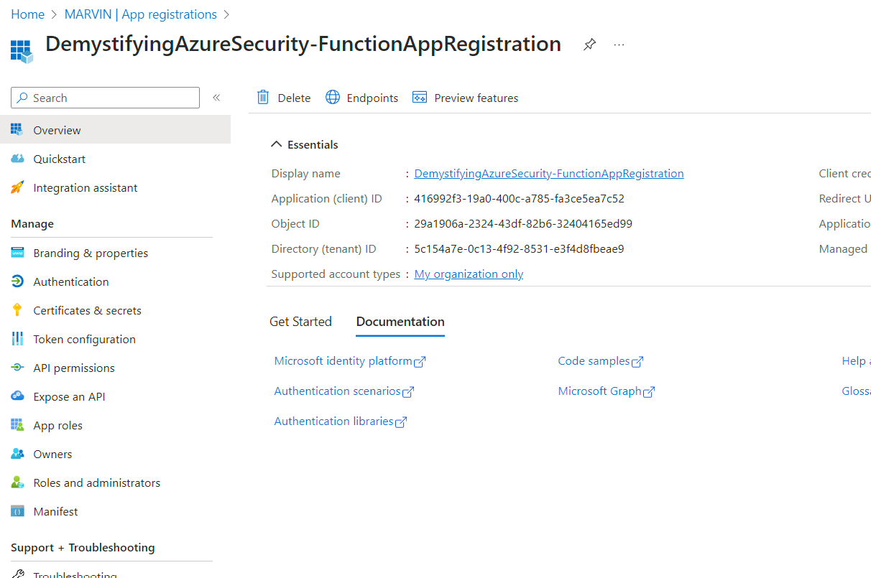
Configuration Options for an Application Object

Slide 13
To access resources that are secured by a Microsoft Entra tenant, the entity that requires access must be represented by a security principal

Slide 14
Another way to look at a security principal is by considering it “a representation of an identity”

Slide 15
This requirement is true for both users (user principal) and applications (service principal)

Slide 16
Security Principal
The security principal defines the access policy and permissions for the users/applications in the Microsoft Entra tenant
  Enables core features such as authentication of the user/application during sign-in, and authorization during resource access

Slide 17
System-based Access

Slide 18

Security Principal Types in Azure
Service principal
Represents the identity of an application
User principal
Represents an actual user

Slide 19
Security principal
Service Principal
User principal

Slide 20
Application Object Vs Service Principal
The application object is the global representation of an application for use across all tenants, and the service principal is the local representation for use in a specific tenant:
  Service principal = an instance of an application object in your tenant
  An application object serves as template for creating corresponding service principal objects (default properties etc)
Application <-> principal = one <-> many

Slide 21
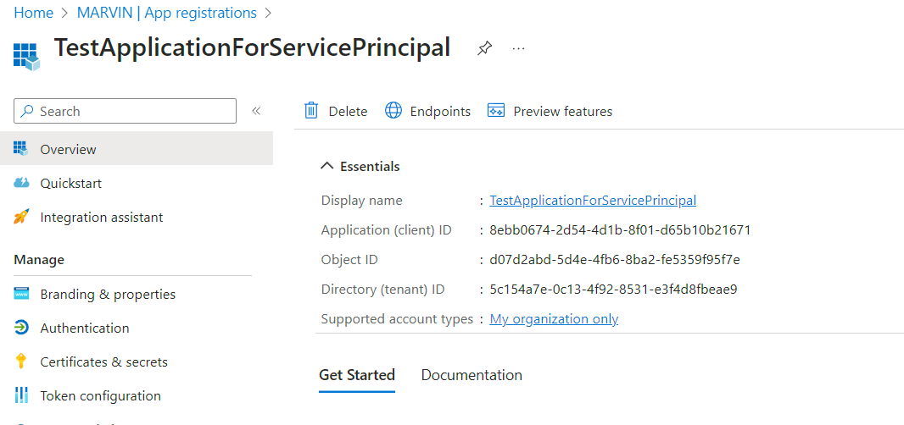
Application Registration in App Registration

Slide 22
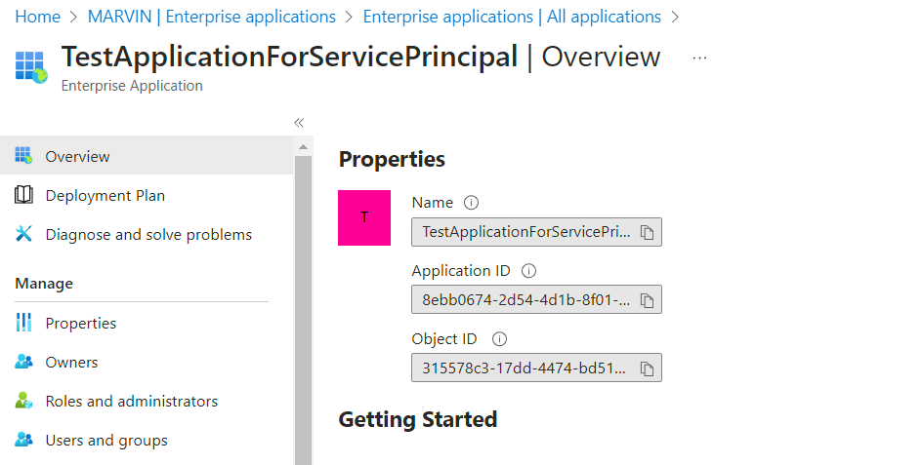
Related Service Principal in Enterprise Applications
Application ID:
- Link to app registration
Object ID:
- Unique identifier in this
tenant

Slide 23
App Registrations Vs Enterprise Applications
Vs
App Registrations
Enterprise Applications
Globally unique application object in Entra ID with unique ID, URI & other URLs & app-specific configurations.
Gets a unique Application ID (in OAuth/OIDC lingo, this becomes the client ID)
Apps published by yourself or other companies in the Entra ID gallery (e.g.: integrate with FB, manage SSO, …)
For your apps, it contains a list of service principal(s) with a unique Object ID, linked to the app via the Application ID

Slide 24
Application objects are managed via the App Registrations blade

Slide 25
Service principals, for your own & external applications, are managed via the Enterprise Applications blade

Slide 26
The result of authentication through a service principal is a token used to access Azure resources

Slide 27



Service Principal Types in Azure
Application
Managed Identity

Slide 28
Security principal
Service Principal
User principal

Slide 29
Security principal
Service Principal
User principal
Application
Managed identity

Slide 30
Security principal
Service Principal
User principal
Application
Managed identity
(legacy)

Slide 31
Application Registration in App Registration
Notes:
Note: same image as used for the app object + principal explanation: that was an app registration + service principal of type “application”

Slide 32
Service Principal of type Application in Enterprise Application
Notes:
Note: same image as used for the app object + principal explanation: that was an app registration + service principal of type “application”

Slide 33
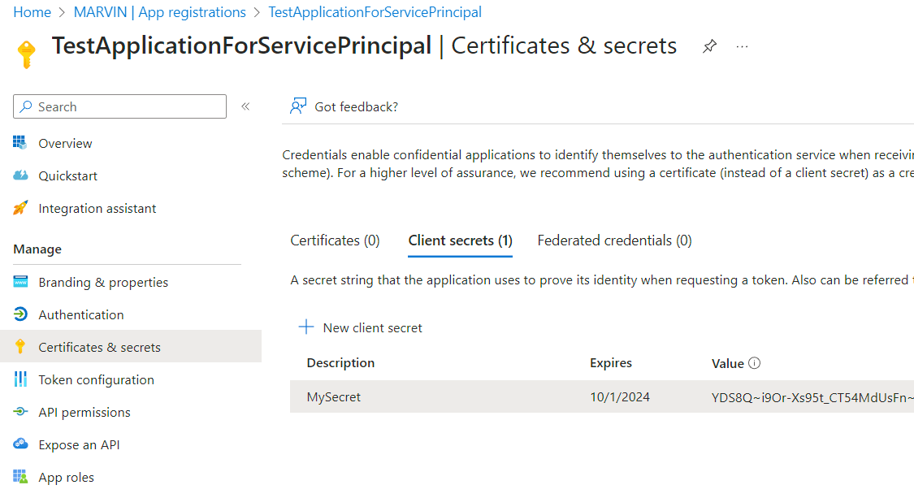
Application Certificate or Secret
Part of the application object configuration, so linked to potentially
multiple service principals

Slide 34
Requesting a Token
POST https://login.microsoftonline.com/5c154a7e-0c13-4f92-8531-e3f4d8fbeae9/oauth2/v2.0/token
Content-Type: application/x-www-form-urlencoded
client_id=8ebb0674-2d54-4d1b-8f01-d65b10b21671&client_secret=YDS8Q~i9Or-Xs95t_CT54MdUsFn~FwB4DYExldhr&grant_type=client_credentials&scope=api://8ebb0674-2d54-4d1b-8f01-d65b10b21671/.default
This is an OAuth2 flow behind the scenes: an authenticated client credentials request to the token endpoint. Scope is a fixed value, which will return all configured permissions for the principal in the token.
Notes:
(reference: https://learn.microsoft.com/en-us/entra/identity-platform/v2-oauth2-client-creds-grant-flow)

Slide 35

Client Credentials Flow
Client application
Entra ID
token request with client authentication
token endpoint
credentials are verified
response body with access token + meta-info
response body with access token + meta-info

Slide 36
Result of the Token Request
{
"token_type": "Bearer",
"expires_in": 3599,
"ext_expires_in": 3599,
"access_token": "eyJ0eXAiOiJKV1QiLCJhbGciOiJSUzI1Ni........SThak70pFXN_Yy7342YMoEOpemdljIYXbypz-_c6_3pobLS78ijDwk37Ju346t4PY_Wtct1ehxCyYl0c0a7iR5jkIDGaEHCdnPw6egfaxaO0s93ASRecWo44hAJ73xTUAWtg"
}
The result is a response which contains an access token. The access token contains the clientid, which is the application id, which is the requested scope root, as audience value: 8ebb0674-2d54-4d1b-8f01-d65b10b21671

Slide 37
Yer Typical Access Token Content
Not necessarily Azure-related
{
“client_id": “the client identifier",
“exp": 123456, // the expiration time, in Unix time
“aud": “the intended audience of the token”,
“scope”: [“read”, “write”, …] // the scope of access the token provides
“iss”: “the issuer of the token” // eg: the URI of your Entra ID
...
}
A bunch of claims, standardized or not, related to a client app or a user, that can be used to allow or disallow access to the intended audience or inside of the intended audience

Slide 38
Validating the Token
It’s still up to the API code (or a layer in front of it) to validate this incoming token.
  Typically, in .NET: JwtBearer authentication middleware (https://www.nuget.org/packages/Microsoft.AspNetCore.Authentication.JwtBearer)

Slide 39
Token Validation in API Management: validate-jwt
<validate-jwt failed-validation-httpcode="401" failed-validation-error-message="Unauthorized" require-expiration-time="true" require-scheme="Bearer" require-signed-tokens="true" clock-skew="0">
<openid-config url="the OIDC well-known URL">
<audiences>
<audience>valid audience</audience>
</audiences>
</validate-jwt>
Scenario: you want APIM to handle token validation, e.g. before calling a downstream API. Incoming requests must have a Bearer token in the Authorization header.
Valid audience checks (& other types of validation configuration, like issuer validation) are possible
Notes:
(reference: https://learn.microsoft.com/en-us/azure/api-management/validate-jwt-policy)

Slide 40
Token Validation in API Management: validate-azure-ad-token
<validate-azure-ad-token tenant-id="Azure AD tenant ID">
<client-application-ids>
<application-id>Azure AD application/client ID</application-id>
</client-application-ids>
</validate-azure-ad-token>
Alternative to validate-jwt if you’re working with Entra ID
The application (client) ID is validated, but backend application id, audience & required claim validation & values are possible as well
Notes:
(reference: https://learn.microsoft.com/en-us/azure/api-management/validate-azure-ad-token-policy)

Slide 41
Requesting a Token in API Management
<send-request ignore-error="true" timeout="20" response-variable-name="bearerToken" mode="new">
<set-url>{{authorizationServer}}</set-url>
<set-method>POST</set-method>
<set-header name="Content-Type" exists-action="override">
<value>application/x-www-form-urlencoded</value>
</set-header>
<set-body>
@{ return "client_id={{clientId}}&scope={{scope}}&client_secret={{clientSecret}}&grant_type=client_credentials"; }
</set-body>
</send-request>
Scenario: you want to call something (an API, a logic app, …) that’s protected with a token from inside APIM. This snippet fetches a token, using the service principal.
Notes:
(reference: https://github.com/Azure/api-management-policy-snippets/blob/master/examples/Get%20OAuth2%20access%20token%20from%20AAD%20and%20forward%20it%20to%20the%20backend.policy.xml)

Slide 42
Requesting a Token in API Management
<set-header name="Authorization" exists-action="override">
<value> @("Bearer " + (String)((IResponse)context.Variables["bearerToken"]).Body.As<JObject>()["access_token"])
</value>
</set-header>
Scenario: you want to call something (an API, a logic app, …) that’s protected with a token from inside APIM. This snippet sets the Authorization header for outgoing requests.

Slide 43


Main Application Service Principal Disadvantages
Secrets / certificates can be exposed, as clients need to know them
Secrets and certificates expire, which means additional management is required

Slide 44
Managed Identity
A managed identity is an automatically managed service principal in Entra ID that eliminates the need to manually manage credentials. They are supported by any resource that supports Entra authentication.
Managed Identity

Slide 45


Managed Identity Types
System-assigned managed identity
User-assigned managed identity

Slide 46
Security principal
Service Principal
User principal
Application
Managed identity
(legacy)

Slide 47
Security principal
Service Principal
User principal
Application
Managed identity
(legacy)
System-assigned
User-assigned

Slide 48
Which Operations Can You Perform on Managed Identities?
Vs
System-assigned
User-assigned
Enable or disable at resource level
Use RBAC to grant permissions
View related operations (CRUD) in Azure Activity Logs
View sign-in activity in Entra ID logs
Create, read, update and delete the identity
Use RBAC to grant permissions
Assign them to one or more resources
View related operations (CRUD) in Azure Activity Logs
View sign-in activity in Entra ID logs

Slide 49


Using Managed Identities
Create the managed identity (automatically with system-assigned, or manually with user-assigned) for a resource
Authorize the managed identity to have access to the target service: the thing you want to secure
Use the managed identity to access a resource

Slide 50

Using Managed Identities
Create the managed identity (automatically with system-assigned, or manually with user-assigned) for a resource
Authorize the managed identity to have access to the target service: the thing you want to secure
Use the managed identity to access a resource

Slide 51
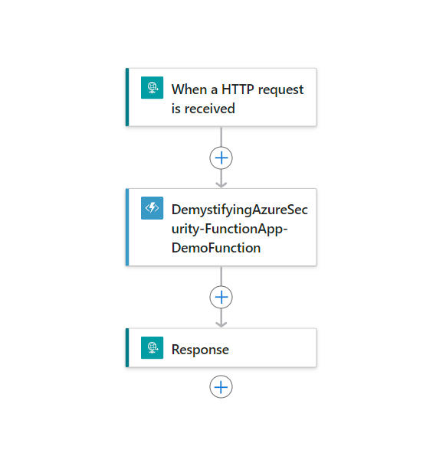
Logic App Calls Function

Slide 52
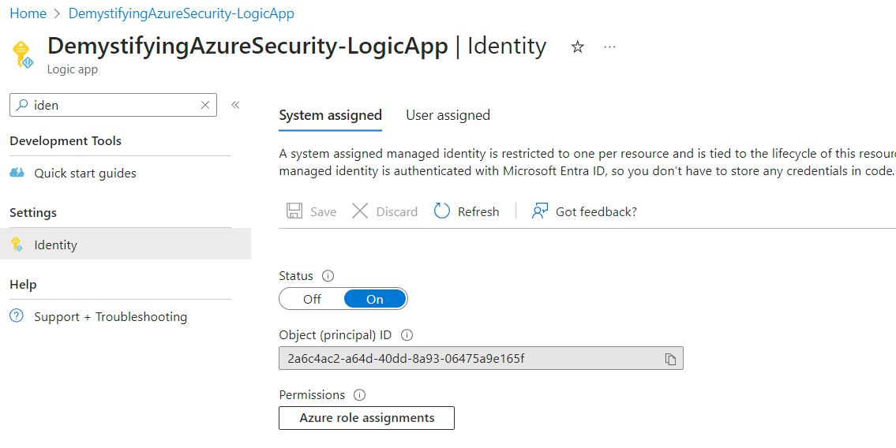

Slide 53
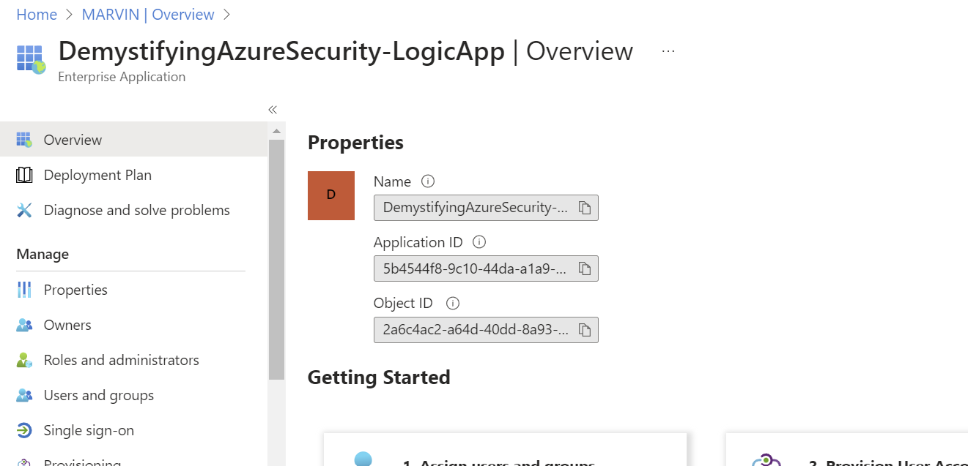
Identity is Automatically Registered as Enterprise Application in Entra ID

Slide 54
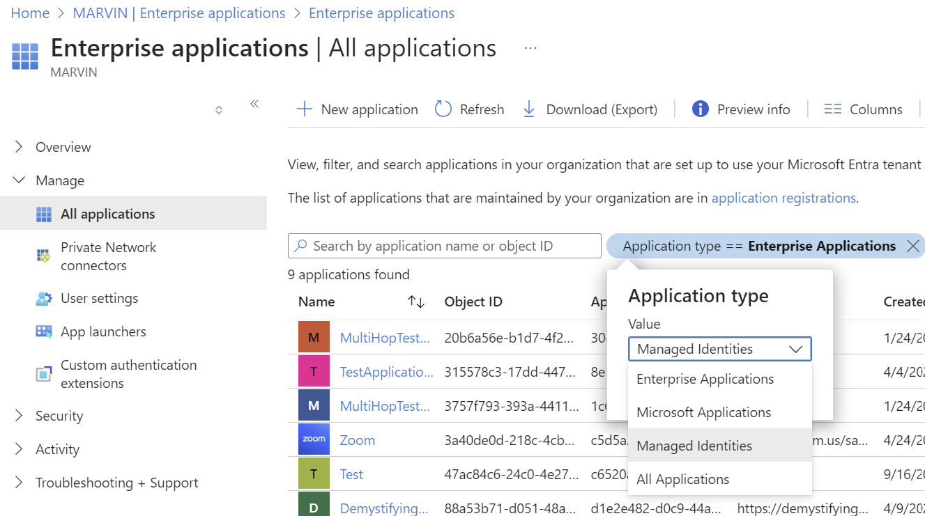
The Type of the Enterprise Application is… NOT Enterprise Application…
To find managed
identities
on the enterprise
application blade,
change the
application type
filter

Slide 55

Using Managed Identities
Create the managed identity (automatically with system-assigned, or manually with user-assigned) for a resource
Authorize the managed identity to have access to the target service: the thing you want to secure
Use the managed identity to access a resource

Slide 56
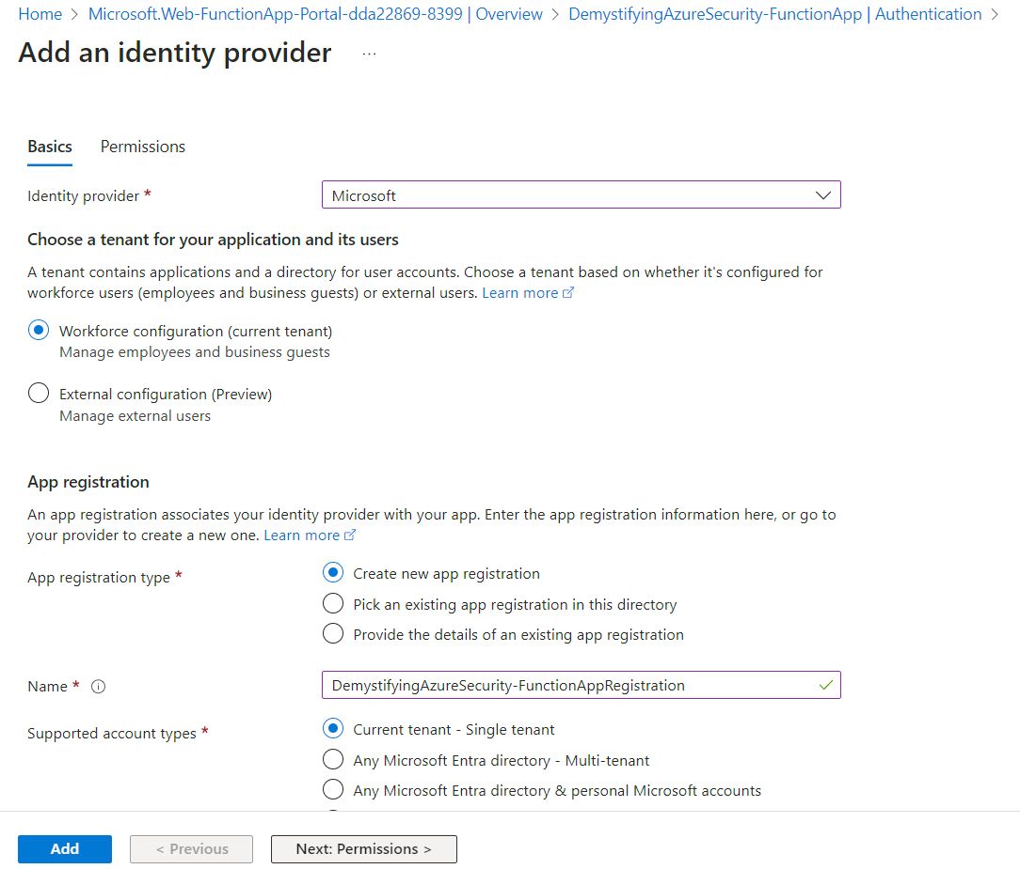
Enable Authentication with Entra ID for Function

Slide 57
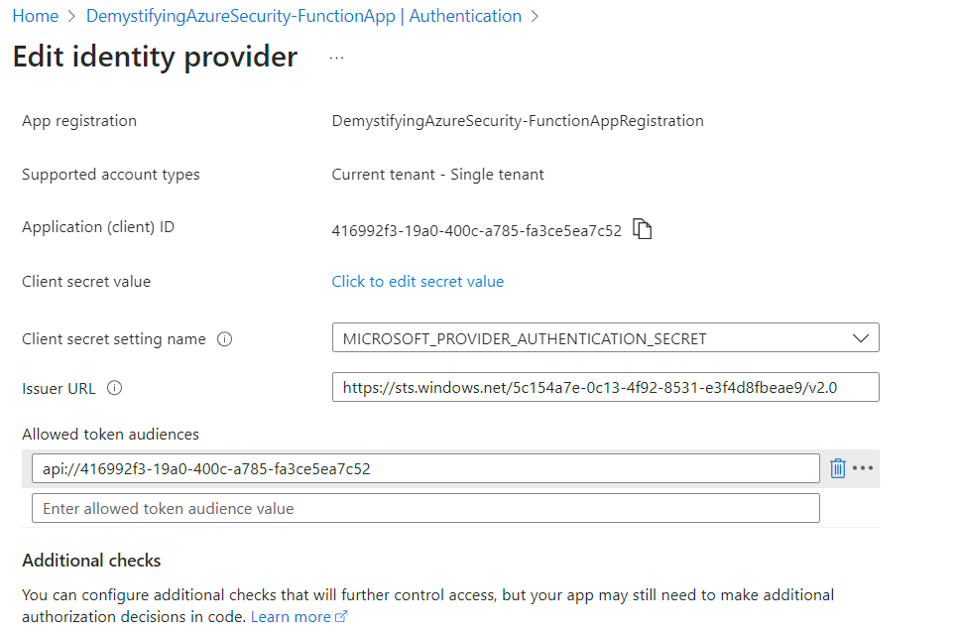
Note the Allowed Token Audience
The token audience
=
intended consumer of the token
=
application (client) ID

Slide 58
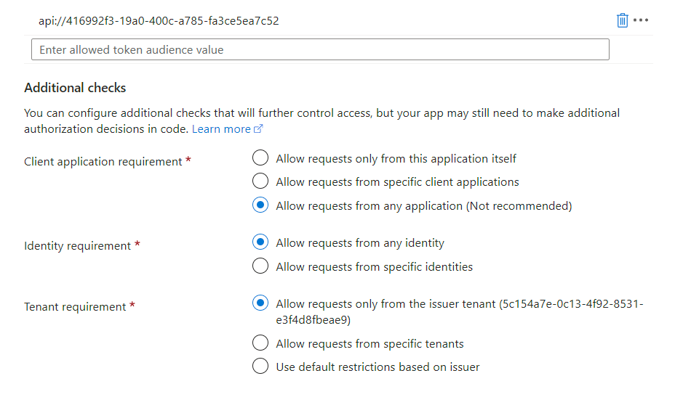
Additional Checks (Authorization)

Slide 59
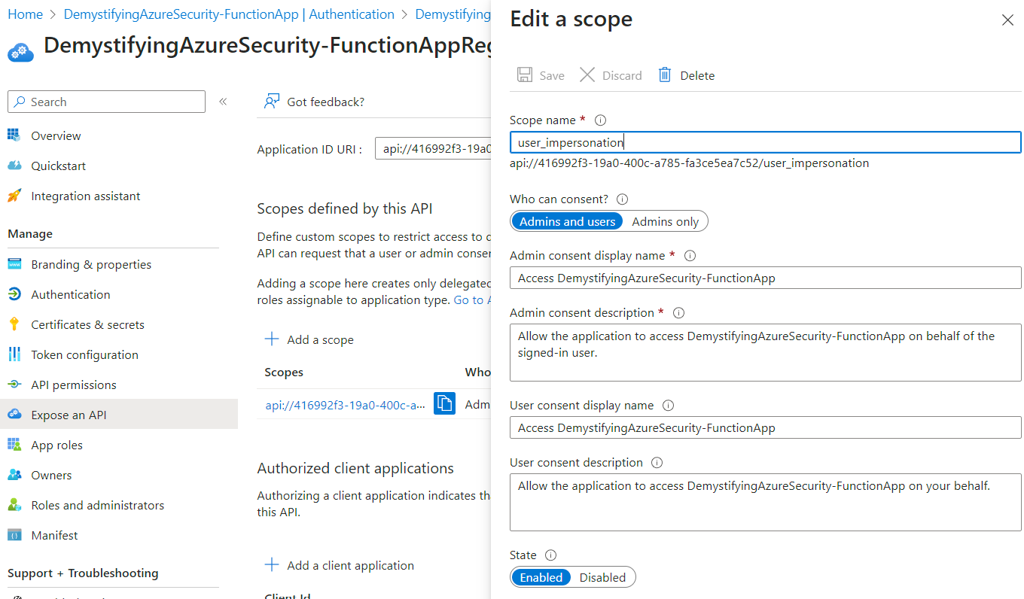
App Registration is Created with Exposed API

Slide 60
Using Managed Identities
Create the managed identity (automatically with system-assigned, or manually with user-assigned) for a resource
Authorize the managed identity to have access to the target service: the thing you want to secure
Use the managed identity to access a resource

Slide 61
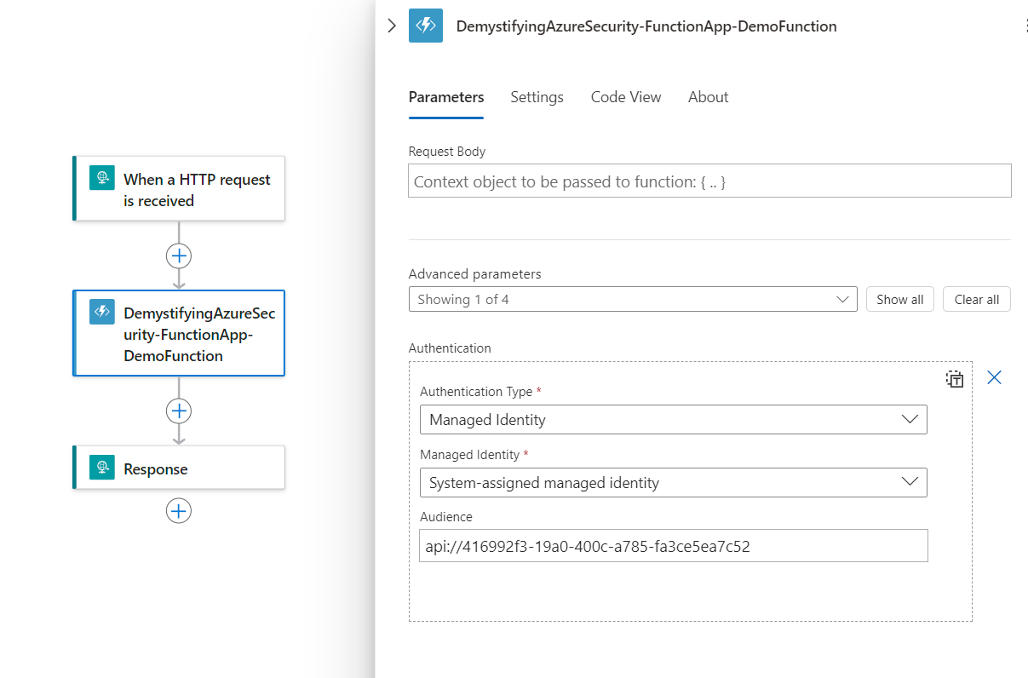
Logic App: Enable Managed Identity Authentication
Requested audience
=
Consumer of the token
=
the allowed audience /
application (client) ID
of the function app

Slide 62
Requesting a Token with Managed Identity
System-assigned:
GET IDENTITY_ENDPOINT?resource=the-resource-you-want-to-access&api-version=2019-08-01 HTTP/1.1
X-IDENTITY-HEADER: 853b9a84-5bfa-4b22-a3f3-0b9a43d9ad8a
User-assigned:
GET IDENTITY_ENDPOINT?resource=the-resource-you-want-to-access&client_id=the-client-id&api-version=2019-08-01 HTTP/1.1
X-IDENTITY-HEADER: 853b9a84-5bfa-4b22-a3f3-0b9a43d9ad8a
From inside an App Service & Azure Function, an internally accessible REST endpoint can be used to fetch a token if needed (e.g.: via Kudu’s Powershell))
Notes:
Referense: https://stackoverflow.com/questions/75141700/azure-oauth-token-retrieval-with-user-managed-identity
Code samples (VM, but likewise for others): https://learn.microsoft.com/en-us/entra/identity/managed-identities-azure-resources/how-to-use-vm-token

Slide 63
Requesting a Token with Managed Identity
In case of a user-assigned managed identity, include:
  The identity’s client ID (query param: client_id)
  OR principal ID (query param: principal_id)
  OR Azure resource ID (query param: msi_res_id)

Slide 64
Requesting a Token with Managed Identity: Sample Response
{
"token_type": "Bearer",
"expires_on": "1586984735",
"resource": "the-resource-you-want-to-access",
"access_token":"eyJ0eXAiOiJKV1QiLCJhbGciOiJSUzI1Ni........SThak70pFXN_Yy7342YMoEOpemdljIYXbypzc6_3pobLS78ijDwk37Ju346t4PY_Wtct1ehxCyYl0c0a7iR5jkIDGaEHCdnPw6egfaxaO0s93ASRecWo44hAJ73xTUAWtg“
}

Slide 65
Behind the Scenes
When you enable managed identity, a local endpoint is set up. This is made available via two environment variables:
  IDENTITY_ENDPOINT: the URL to the local token service
  X-IDENTITY_HEADER: the secret

Slide 66
Behind the Scenes
The IDENTITY_ENDPOINT is a local URL, only reachable from inside your service, from which your service/app can request tokens
The port & secret are recreated multiple time a day

Slide 67
Requesting a Token in API Management with Managed Identity
<authentication-managed-identity
resource=“appid of target, the resource you want to access"
client-id="clientid of user-assigned identity (system identity is assumed if empty)"
output-token-variable-name="token-variable"
ignore-error="true|false"/>
Gets a token, sets the Authorization header & caches the token until it expires
Notes:
(reference: https://learn.microsoft.com/en-us/azure/api-management/authentication-managed-identity-policy)

Slide 68
On APIM, validating the token
<validate-azure-ad-token …/>
<validate-jwt …/>
The same policies as before are used: you’re validating the token itself; it doesn’t matter through which identity it was generated: that’s not part of the token validation process

Slide 69
Managed identities solve the main issues of regular service principals

Slide 70
Main Managed Identity Service Principal Disadvantages
Less flexibility: you cannot manage the token content
Generating a token through it is an Azure-only thing

Slide 71
(Real-life) User-based Access

Slide 72
Security principal
Service Principal
User principal
Application
Managed identity
(legacy)
System-assigned
User-assigned

Slide 73
User Principal
A principal representing an individual user, typically used for humans

Slide 74


Token-based Security is Better with Standards
Standards evolve
Best practices evolve

Slide 75
OAuth2 and OIDC
Best practices
  OAuth 2.0 Security Best Current Practice: https://datatracker.ietf.org/doc/html/draft-ietf-oauth-security-topics-25
  The OAuth 2.1 Authorization Framework:
  https://datatracker.ietf.org/doc/draft-ietf-oauth-v2-1/10/

Slide 76
OAuth2: Access Tokens
Provide access to protected resources
Carry authorization information (scopes, permissions)
Relatively long-lived
  Important to store these safely
  Even more so for refresh tokens!
Sent as Bearer tokens to an API / resource
  Validated at that level

Slide 77
OpenID Connect: Identity Tokens
Help establish a user’s identity
  Potentially contains user claims
Relatively short-lived
Validated & used a level of the client app
  Typically results in an authentication ticket in a cookie

Slide 78
So, why not use access tokens for user identification then? Or identity tokens to call an API?
Notes:
Refer

Slide 79







OAuth2 & OIDC: High-level View
Entra ID
Client application (relying party)
API

Slide 80
Flow
A flow determines how tokens are delivered to the client application

Slide 81
Client Authentication
During a flow, clients may need to authenticate to talk to certain endpoints, typically the token endpoint
  Different means of authentication exist

Slide 82



The Authorization Code Flow + PKCE + UserInfo
Client application (relying party)
IDP
create code_verifier
hash (SHA256)
code_challenge
authentication request + code_challenge
authorization endpoint
store code_challenge
user authenticates
(user gives consent)
code
code
token request (code, clientid, clientsecret, code_verifier)
token endpoint

Slide 83

The Authorization Code Flow + PKCE + UserInfo
Client application (relying party)
IDP
token request (code, clientid, clientsecret, code_verifier)
token endpoint
hash code_verifier
check if it matches the
stored code_challenge
id_token, access_token
id_token, access_token
token validation
userinfo request (access_token)
userinfo endpoint

Slide 84

The Authorization Code Flow + PKCE + UserInfo
Client application (relying party)
IDP
userinfo request (access_token)
userinfo endpoint
user claims
user claims
access_token (as Bearer token in Authorization header)

Slide 85
The Authorization Code Flow + PKCE + UserInfo
IDP
API
userinfo request (access_token)
userinfo endpoint
user claims
user claims
access_token (as Bearer token in Authorization header)

Slide 86
How do we get Entra ID to behave according to the current best practice?

Slide 87
The Microsoft Identity Platform, ADAL, MSAL, …
Know that implement OAuth2/OIDC flows is, essentially, a matter of sending a bunch of requests & parsing responses. There is no need to use MSAL or any of the other libraries.
  I prefer the built-in OIDC middleware in ASP.NET Core, combined with IdentityModel

Slide 88
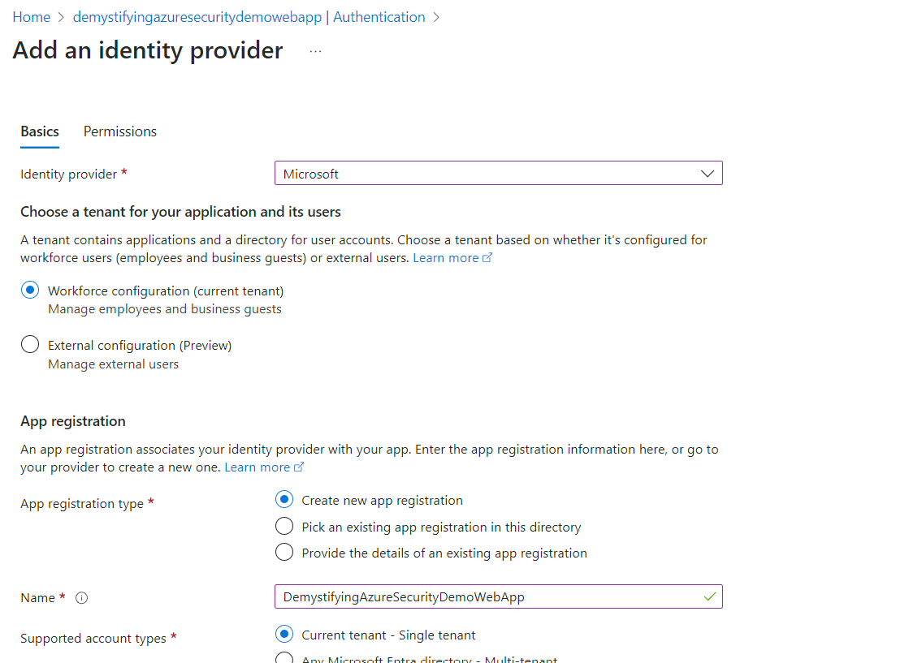
Add an Identity Provider (Web App)

Slide 89
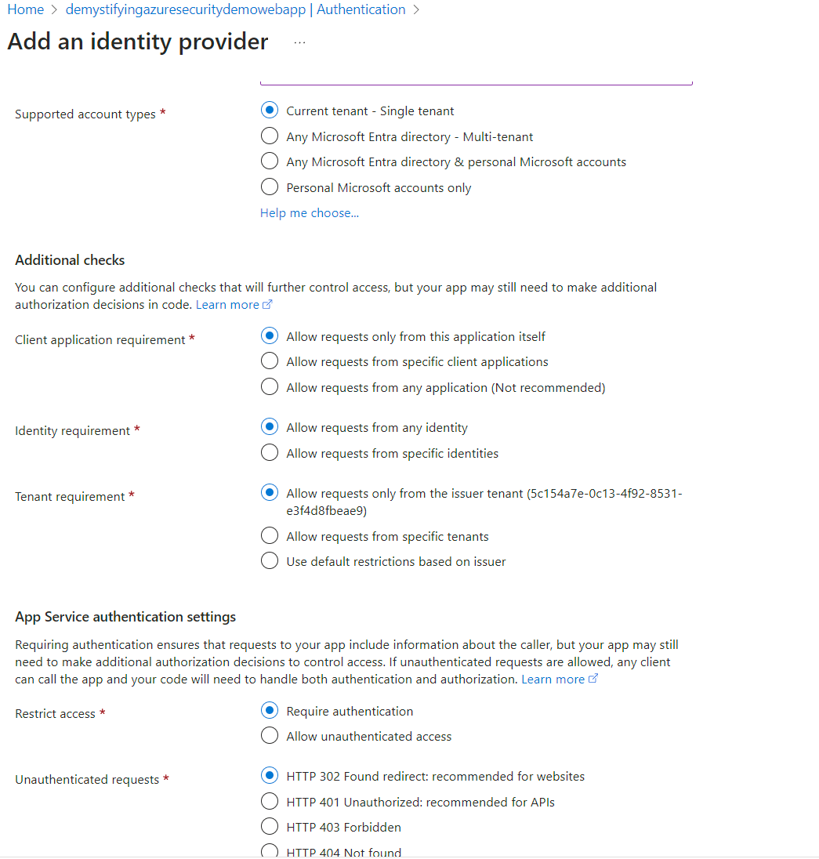

Slide 90
Disable the Implicit Flow
Identity & access tokens are returned via the front channel from the authorization endpoint
  This makes them visible to the browser
  This makes them more prone to interception

Slide 91
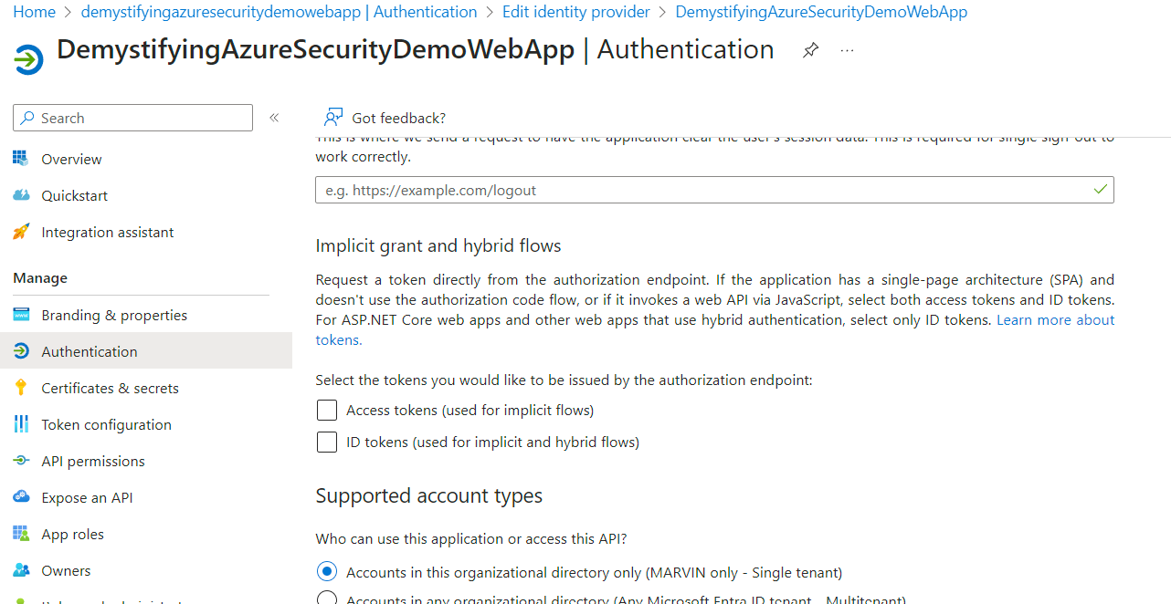
Disable the Implicit Flow

Slide 92
Disable the Implicit Flow
"logoUrl": null,
"logoutUrl": null,
"name": "DemystifyingAzureSecurityDemoWebApp",
"notes": null,
"oauth2AllowIdTokenImplicitFlow": false,
"oauth2AllowImplicitFlow": false,
"oauth2Permissions": [
{
"adminConsentDescription": "Allow the application to access demystifyingazuresecuritydemowebapp on behalf of the signed-in user.",
You can also disable it in the manifest file directly

Slide 93
If I can’t use the implicit flow, should I use the code flow from my (JavaScript) client?
Common question?

Slide 94
Don’t trigger flows from a (JavaScript) client. Use the server (BFF pattern): code flow + PKCE + client authentication.

Slide 95
PKCE
Proof Key for Code Exchange protects against code interception attacks when using the authorization code flow
Reference: https://datatracker.ietf.org/doc/html/rfc7636

Slide 96


Use PKCE
Public clients
Authorization code flow without PKCE is disabled out of the box
Confidential clients
Authorization code flow without PKCE is not disabled, but it’s recommended to use it. Pass through a code_challenge and code_challenge_method to force it.

Slide 97
Use PKCE
https://login.microsoftonline.com/{tenant}/oauth2/v2.0/authorize?
client_id=535fb089-9ff3-47b6-9bfb-4f1264799865
&response_type=code
&redirect_uri=http%3A%2F%2Flocalhost%2Fmyapp%2F
&response_mode=query
&scope=https%3A%2F%2Fgraph.microsoft.com%2Fmail.read
&state=12345
&code_challenge=YTFjNjI1OWYzMzA3MTI4ZDY2Njg5M2RkNmVjNDE5YmEyZGRhOGYyM2IzNjdmZWFhMTQ1ODg3NDcxY2Nl
&code_challenge_method=S256
Pass through a code_challenge & code_challenge_method to force PKCE. Accessing the token endpoint won’t be possible without passing through a code_verifier, which is created from the challenge & verified at level of the token endpoint.

Slide 98
Improve Client Authentication
By default, calls to the token endpoint are secured with a clientid & secret
Use a certificate instead (add one via the “Certificates & secrets” blade)

Slide 99
Use a Certificate for Client Authentication
POST /{tenant}/oauth2/v2.0/token HTTP/1.1
Host: login.microsoftonline.com
Content-Type: application/x-www-form-urlencoded
client_id=535fb089-9ff3-47b6-9bfb-4f1264799865
&scope=https%3A%2F%2Fgraph.microsoft.com%2Fmail.read
&code=OAAABAAAAiL9Kn2Z27UubvWFPbm0gLWQJVzCTE9UkP3pSx1aXxUjq3n8b2JRLk4OxVXr...
&redirect_uri=http%3A%2F%2Flocalhost%2Fmyapp%2F
&grant_type=authorization_code
&code_verifier=ThisIsntRandomButItNeedsToBe43CharactersLong
&client_assertion_type=urn%3Aietf%3Aparams%3Aoauth%3Aclient-assertion-type%3Ajwt-bearer
&client_assertion=eyJhbGciOiJSUzI1NiIsIng1dCI6Imd4OHRHeXN5amNScUtqRlBuZDdSRnd2d1pJMCJ9.eyJ{a lot of characters here}M8U3bSUKKJDEg
Fixed value for client_assertion_type: urn:ietf:params:oauth:client-assertion-type:jwt-bearer
Derived value for client_assertion: a JWT that identifies your confidential app & is signed with the certificate’s private key
Notes:
(reference: https://learn.microsoft.com/en-us/entra/identity-platform/certificate-credentials)

Slide 100


Should You Use the UserInfo Endpoint?
Lowers the size of the identity token: better for URL length restrictions (applicable if returned via the front channel)
Back-channel communication: less susceptible to interception
OIDC libraries often standardize on this
Additional network request

Slide 101
Should You Use the UserInfo Endpoint?
The advantages don’t apply to the authorization code flow, as tokens are returned via back-channel communication with the token endpoint
  But if you really can’t use that, you want to consider this

Slide 102
Calling the UserInfo Endpoint
POST /oidc/userinfo HTTP/1.1
Host: graph.microsoft.com
Authorization: Bearer eyJ0eXAiOiJKV1QiLCJub25jZSI6Il…
Ensure you request the user.read, openid & other scopes related to the user info you need when triggering the initial OIDC flow. Set the resulting access token as Bearer token on calls to the UserInfo endpoint.

Slide 103
UserInfo Response
{
"sub": "OLu859SGc2Sr9ZsqbkG-QbeLgJlb41KcdiPoLYNpSFA“,
"name": "Mikah Ollenburg", // all names require the “profile” scope.
"family_name": " Ollenburg",
"given_name": "Mikah",
"picture": "https://graph.microsoft.com/v1.0/me/photo/$value",
"email": "mikoll@contoso.com" // requires the “email” scope.
}

Slide 104
Access Control

Slide 105
Simplest form: authentication as authorization
Notes:
https://learn.microsoft.com/en-us/entra/identity-platform/authorization-basics

Slide 106
One step beyond: Access Control Lists (ACLs)
Notes:
Examples: client ID restrictions, IP restrictions – seen before on slide.
https://learn.microsoft.com/en-us/entra/identity-platform/authorization-basics

Slide 107
Azure role-based access control (Azure RBAC) is the authorization system you use to manage access to Azure resources

Slide 108
Role-based Access Control
To grant/deny access, you assign roles to users (user principals), groups, service principals (including managed identities) at a particular scope
  The scope is the set of resources the access applies to (resource, resource group, subscription, management group)

Slide 109
Role-based Access Control
Some roles are built-in (Owner, Contributor, Reader, …), but custom roles can be created
  Assign permissions to custom roles for fine-grained access to Azure resources

Slide 110
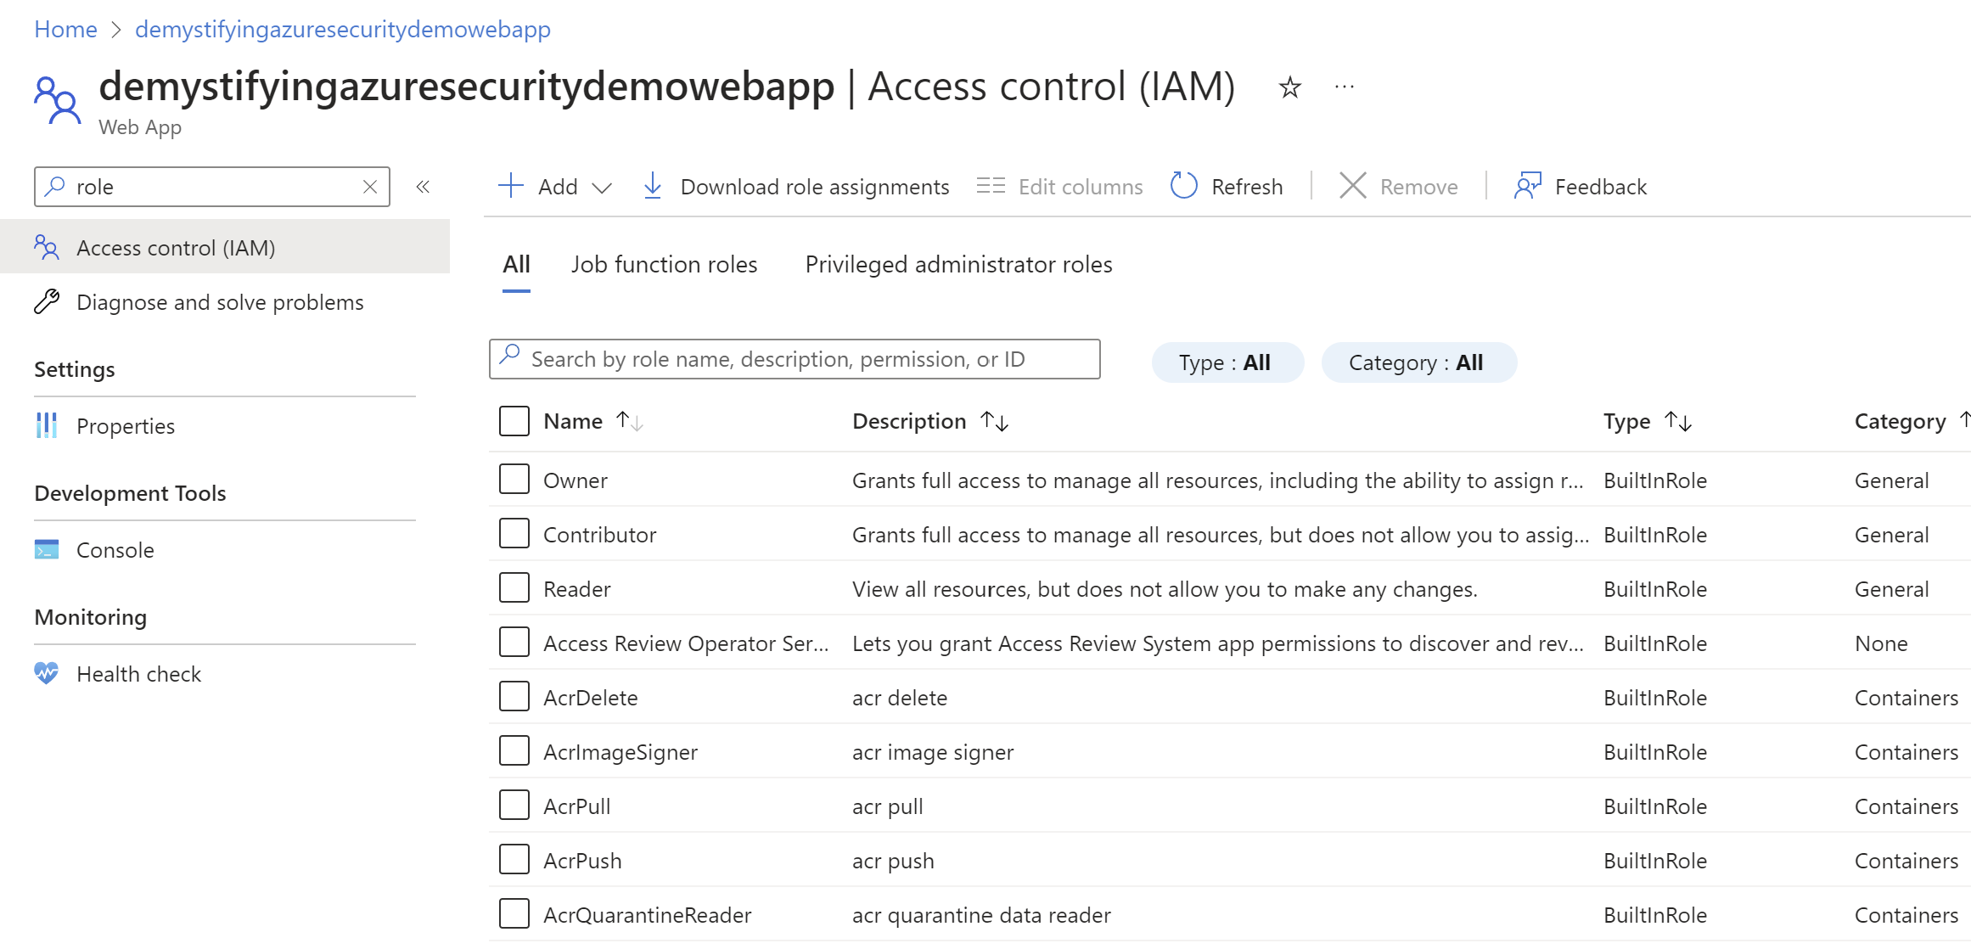
Role-based Access Control

Slide 111
Role-based Access Control
Particularly useful for managing a user principals’ access rights on Azure resources:
  Allow user X to manage virtual machines in a subscription, but not databases
  Allow user Y to manage resources in a certain resource group, but not in the complete subscription
  …

Slide 112
Role-based Access Control
Can also be useful for managing a service principal’s level of access to Azure resources
  Allow a system-assigned managed identity read (and only read) access to one specific resource
  Allow a user-assigned managed identity full access to all resources in a certain resource group

Slide 113
Role-based Access Control
RBAC tends to becomes cumbersome & hard to manage once you try to use it for fine-grained access control
  The number of roles tends to spiral out of control

Slide 114
Azure attribute-based access control (Azure ABAC) allows more manageable, fine-grained approach over RBAC

Slide 115
Attribute-based Access Control
Azure ABAC is enabled via role assignment conditions (based on attributes in the context of specific actions), built on top of RBAC
  Currently enabled for blob storage & queue storage data actions
Notes:
Attribute-based access control (ABAC) is an authorization system that defines access based on attributes associated with security principals, resources, and the environment of an access request. With ABAC, you can grant a security principal access to a resource based on attributes. Azure ABAC refers to the implementation of ABAC for Azure.
https://learn.microsoft.com/en-us/azure/role-based-access-control/conditions-overview

Slide 116
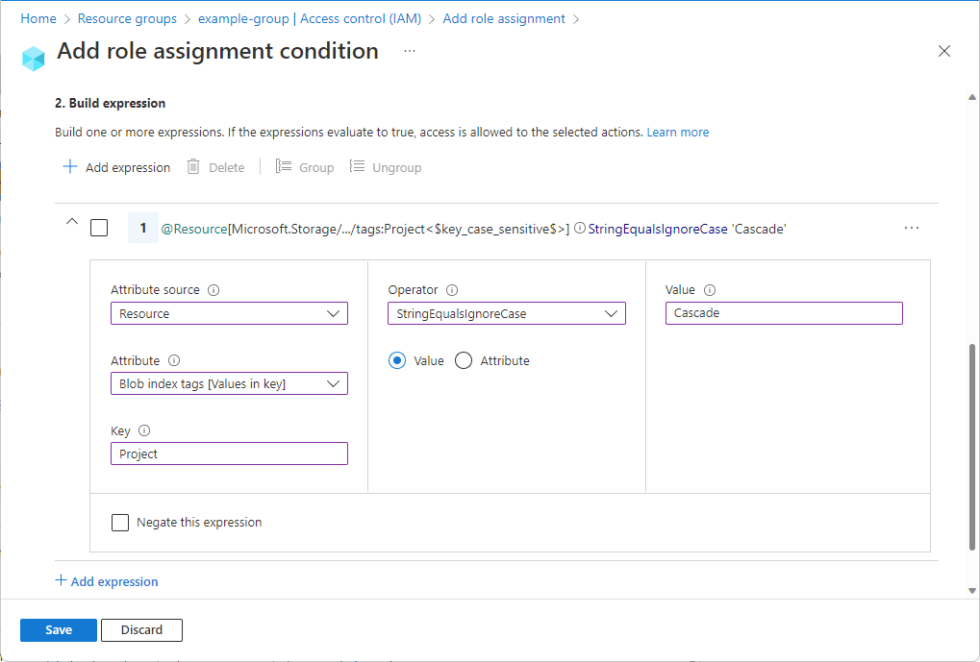
Azure ABAC

Slide 117
Do not confuse this with application roles (via Entra ID App Roles)!

Slide 118
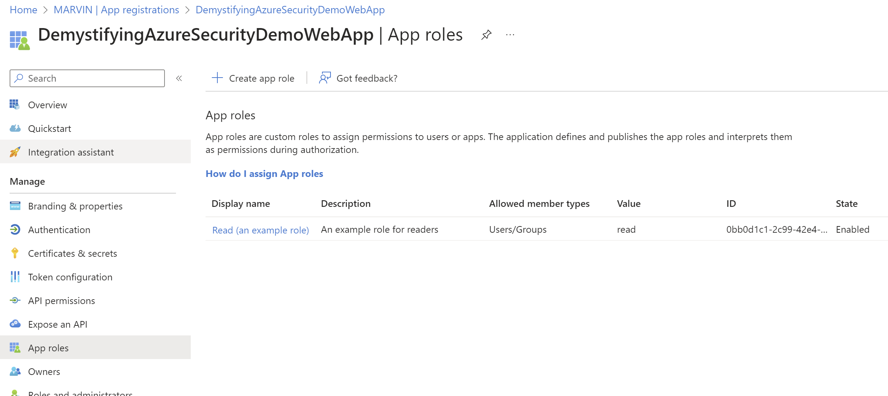
App Roles

Slide 119
App Roles
Microsoft Entra External ID allows you to define application roles for your application and assign those roles to users and groups
  The roles you assign to a user or group define their level of access to the resources and operations in your application
  These roles end up in the token, where applications can parse them from
Notes:
Reference: https://learn.microsoft.com/en-us/entra/external-id/customers/how-to-use-app-roles-customers & https://learn.microsoft.com/en-us/entra/identity-platform/howto-implement-rbac-for-apps

Slide 120
App Roles
Here, too, RBAC tends to becomes cumbersome & hard to manage once you try to use it for fine-grained application-specific access control
  The number of roles tends to spiral out of control
Prefer an ABAC, non-Azure approach

Slide 121
Questions?
@KevinDockx / kevin.dockx@gmail.com
GitHub:
https://github.com/KevinDockx
Pluralsight courses: https://app.pluralsight.com/profile/author/kevin-dockx

