Slide 1
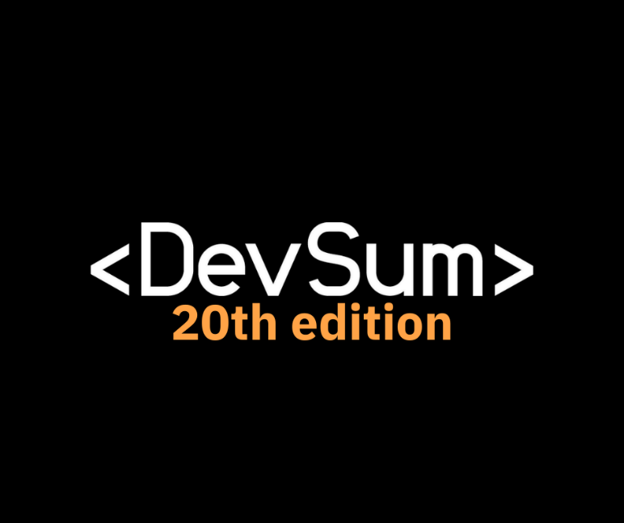
Data Science in Microsoft Fabric Andrew J. Brust

Slide 2
Meet Andrew
Founder and CEO
Strategy, advisory for vendors in the analytics realm
Big Data reporter for The New Stack
Data and Analytics lead for GigaOm
Microsoft Regional Director, MVP
Co-chair Visual Studio Live!

Slide 3
What is Fabric?
End-to-End
Uses numerous Microsoft technologies underneath
OneLake
No Azure account needed
Paid for on a SaaS basis

Slide 4
Fabric Data Science Components
Experiments, Models
Notebooks
MLflow
Apache Spark, PySpark, Spark ML, Scikit-learn, LightGBM
FLAML
SynapseML

Slide 5
Notebooks
Jupyter-compatible. Can run in VS Code
Languages, cells, code, markdown
Auto-save
Resources and default lakehouse
%pip or %conda install
Environments
Spark sessions usually start up within a few seconds

Slide 6
DEMO
Notebooks

Slide 7
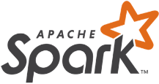
Apache Spark
Big Data/Data Lake framework, originally viewed as a competitor to Apache Hadoop
Very memory-oriented. Compare to Hadoop’s disk-heavy approach. Eliminates lots of latency.
Great for all variety of data preparation/engineering and analytics work, as well as machine learning
Workloads can be comingled in a single job using very dev-friendly APIs
PySpark DataFrames are in-memory result sets used throughout PySpark

Slide 8
Python, PySpark, Pandas, and DataFrames
Python is the lingua franca of data science and data engineering
PySpark is the Python library for Apache Spark
Pandas is a Python library for data analysis and cleansing
DataFrames are the standard structure for working with data/result sets
Pandas “invented” them; Spark/PySpark has its own
They’re compatible, but some tasks require one or the other
In general, Pandas runs locally while Spark is distributed across nodes in a cluster

Slide 9
DEMO
Python, Spark and DataFrames

Slide 10
ML 101
Train, test, eval model
Features, label
String indexing and one-hot encoding
VectorAssemblers
Fit & transform (train & test/predict)
Accuracy: AUC, RMSE, MAE, R², VAR,

Slide 11
The Fabric Data Science Workflow
Create notebook
Open and explore data
Train
Test
Evaluate
Register model
Create experiment and run

Slide 12
DEMO
Train, Test and Evaluate

Slide 13
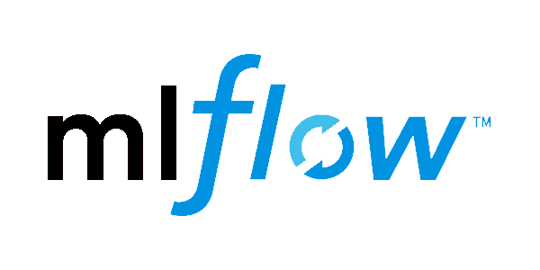
MLflow
Open source MLflow provides Fabric with experiment tracking and a model registry
User interface
Compare experiment runs
Inspect models
Apply (generate predictions)

Slide 14
MLflow API
Experiments: set_experiment
Runs: start_run, get_run
Models: register_model, load_model, model.name, model.version
Parameters & Metrics: log_param(s), log_metric(s), log_model
Autologging

Slide 15
Fabric Experiments and Models
Feature | Description
Run | An end-to-end definition, training and testing of an ML model
Experiment | A collection of iterative runs for a model, with varying hyperparameter values, algorithms
Model | The persisted trained ML model with related assets and metadata
Nesting, versioning | Parent and child models and runs can be defined; multiple versions of same model can exist
How to access | Experiments and models accessible from workspace browser or from within notebooks

Slide 16
SPARK SQL PREDICT Function
Allows scoring of models from Spark SQL instead of the Transform method in Python
Requires model to be in the Fabric/MLflow model registry
Works with PyTorch, Sklearn, Spark, TensorFlow, ONNX, XGBoost, LightGBM, CatBoost, Statsmodels, Prophet, Keras
sqlt = SQLTransformer().setStatement(
f"SELECT PREDICT('{model_name}/{model_version}', {','.join(features)}) as predictions FROM __THIS__")
sqlt.transform(df).show()

Slide 17
DEMO
MLflow Experiments, Runs, Logging, and Registration

Slide 18
Data Wrangler
Browses, profiles, and transforms data
Generates Python code through a menu
Versions for browser, VS Code

Slide 19
Python Coding Tools
Notebook snippets
Data Wrangler “Operations”
Copilot and other generative AI tools!

Slide 20
DEMO
Code Gen Techniques

Slide 21
SynapseML, FLAML
SynapseML
“Open-source library that simplifies…text analytics, vision, anomaly detection, and many others”
Formerly MLSpark
Built on Spark; “…usable across Python, R, Scala, Java, and .NET [C#]”
Reduces verbose ML work into terse, single lines of code
FLAML
Fast Library for Automated Machine Learning
Open source library for machine learning, developed by Microsoft Research, but not used in Azure ML
Makes it easy to tune hyperparameters and determine best ML algorithm

Slide 22
DEMO
ML Training and Evaluation with SynapseML

Slide 23
Hyperparameter Tuning
FLAML + PySpark:
flaml.tune.run
time_budget_s, metric, mode, verbose, log_file_name
num_samples, Tune function, search space
flaml.tune.uniform (for continuous real number values), flaml.tune.randint (for discrete integer values)
pySpark Evaluators
SynapseML
TrainClassifier, FindBestModel, ComputeModelStatistics

Slide 24
FLAML AutoML
AutoML()
fit method
Settings dictionary: time_budget, metric, verbose, log_file_name task, max_iter, seed, mlflow_exp_name If parallelized: use_spark, n_concurrent_trials, force_cancel
Properties: best_config, best_loss, best_config_train_time, best_run_id

Slide 25
DEMO
FLAML AutoML

Slide 26
Semantic Link
Provides a Python API for Power BI semantic models (datasets)
Examine tables, their columns and relationships
Examine and evaluate measures
Add a lakehouse table to the model
Enumerate and render reports
Get and Execute TMSL (Tabular Model Scripting Language)

Slide 27
GenAI on Fabric
Fabric doesn’t have native GenAI capabilities
But by integrating it with Azure OpenAI you can make it work, sometimes rather easily
Can use Azure Cognitive Search for vector database and operations
Integrate with your Lakehouse data for full effect

Slide 28
DEMO
GenAI on Fabric with Azure OpenAI

Slide 29
Public Datasets
https://azureopendatastorage.blob.core.windows.net/
Multiple containers: xxxdatacontainer, where xxx =
census, holiday, isdweather, nyctlc, etc.
https://mmlspark.blob.core.windows.net/publicwasb
https://pandemicdatalake.blob.core.windows.net/public
https://synapseaisolutionsa.blob.core.windows.net/public
https://azuresynapsestorage.blob.core.windows.net/sampledata
https://nytaxiblob.blob.core.windows.net/2013

Slide 30
Resources
My TNS article on Fabric GA: https://thenewstack.io/microsoft-fabric-goes-ga-adds-multiple-integrations/
Fabric Home Page: https://app.fabric.microsoft.com
Fabric Community: https://community.fabric.microsoft.com/
Fabric on Microsoft Learn: https://learn.microsoft.com/fabric/
Microsoft Fabric Blog: https://blog.fabric.microsoft.com/en-US/blog/

Slide 31
Thank You!
Email
andrew.brust@bluebadgeinsights.com
@andrewbrust

